Slide 1
FIRST SIKH HISTORY CONFERENCE
SGTB Khalsa College, Delhi
5-7 January 2023.
‘SIKH, SIKH EVERYWHERE – SIKH GLOBAL PRESENCE’
Swarn Singh Kahlon

Slide 2
HIGHLIGHTS
10% of Sikhs live abroad - while overall Indians abroad 2%.
In many cases Sikhs were pioneer migrants despite belonging to a land-locked state.
Maharaja Ranjit Singh – Foreign Connection.
Army generals from Europe - France, Spain, Hungry, Russia, Italy, Greece.
Post Maharaja Ranjit Singh – British Preference for Sikh Soldiers.
Afghanistan - Early 19th century - Maharaja Ranjit Singh
1849 – Maharaja Duleep Singh to UK and later France
1861 – Rani Jindan to UK

Slide 3
GLOBAL MOVEMENT OF SIKHS
1850s – Burma (Second Anglo-Burma War)
China (Second Opium War)
1867 – Hong Kong
1870s – Malaya followed in later years to Indonesia
1880s - Fiji
1890s - Australia and New Zealand
1897 - Kenya and Uganda
1897 - Canada
1898 - USA
1900 - Iran

Slide 4
SIKH MIGRATION – PRESENT STATUS
North America – 1,000,000 (USA - 500k, Canada - 455k).
Europe – 620,000 (UK – 420k, Continental Europe -200k). Italy-80k
Asia Pacific – 300,000 (Malaysia-85k, Australia-72k)
Africa - 60,000
Other countries – 20,000
TOTAL – 2,000,000.
An interesting observation
Prior to Indian independence, Sikh migration was almost 2/3rd to Asia & Africa but post Independence, it is 2/3rd to the West – high income industrialized countries.

Slide 5
EARLIEST GURDWARAS
Burma – 1897
East Africa, Kenya – 1898
Malaysia – 1899
Hong Kong – 1901
Canada – 1908
China, Shanghai – 1908
UK – 1911
USA – 1912
Thailand - 1913

Slide 6
SIKH INITIATIVES
Gurdwaras
Turban Days
Nagar Kirtans
Sikh Youth Camps
Sikh Sewa incl Langars

Slide 7
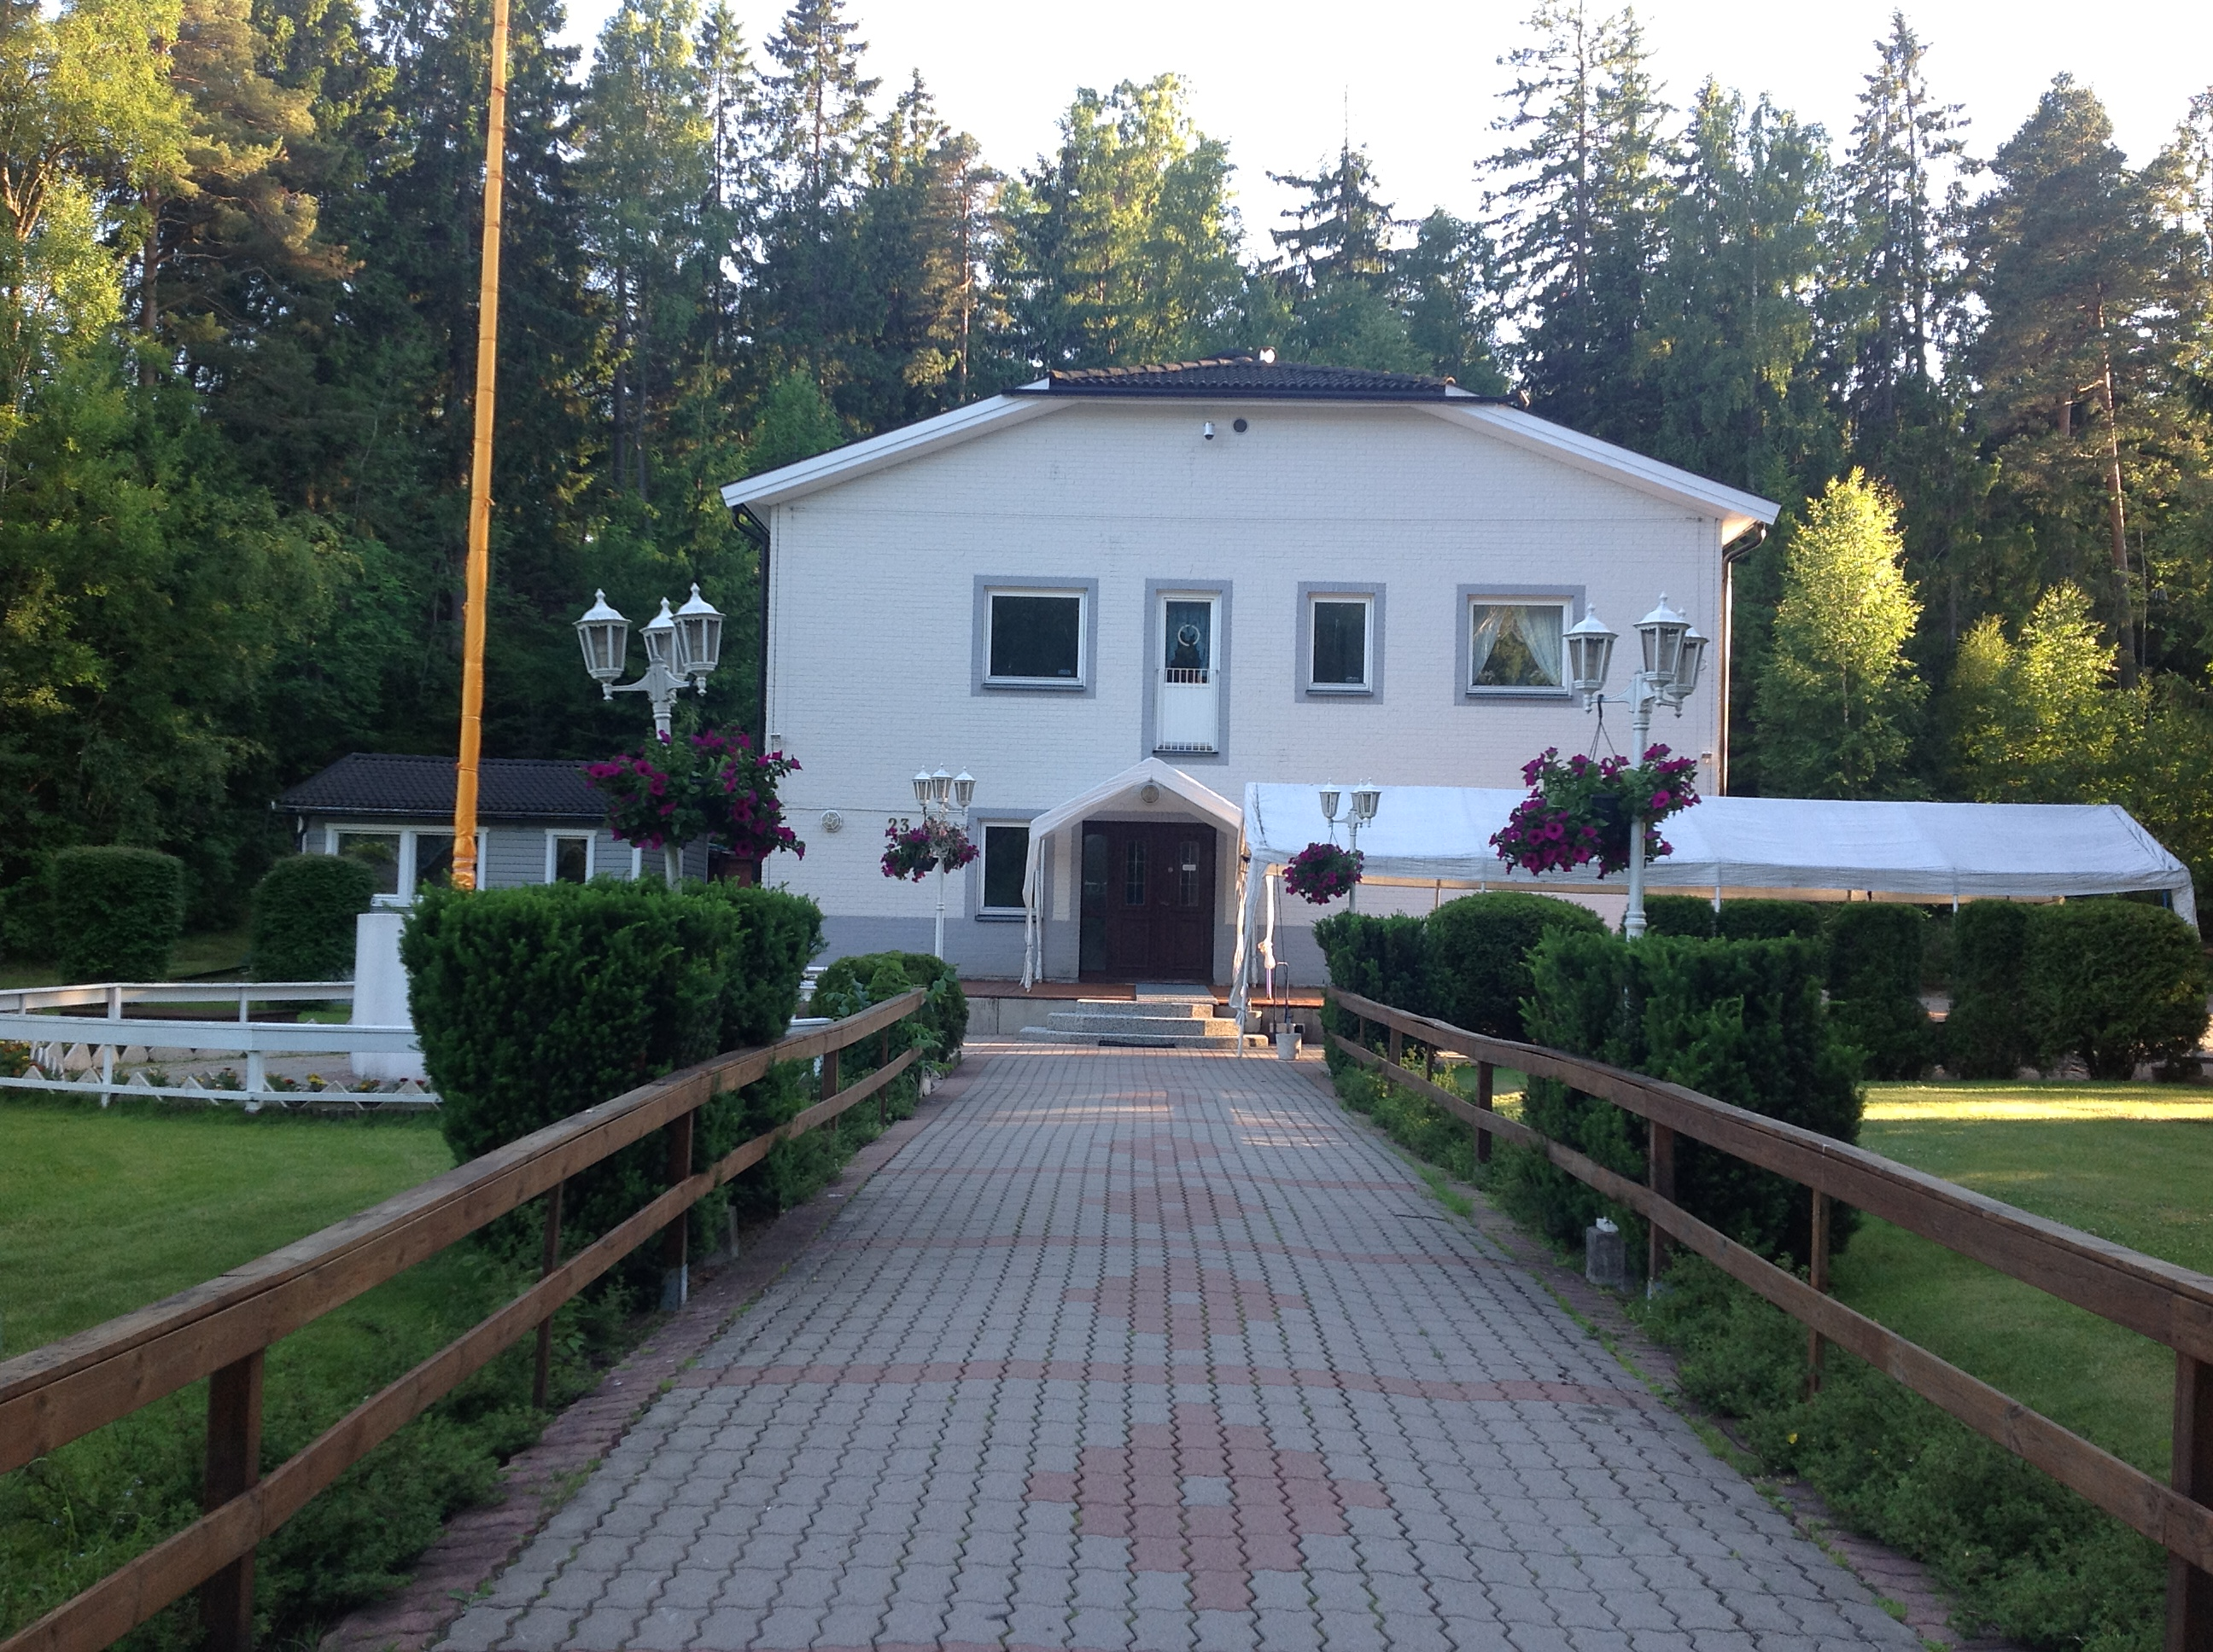
Gurdwara, Stockholm suburb, Sweden

Slide 8
SIKH ISSUES
Illegals - Sad but true especially to Europe (Donkeying)
Sikh Identity (Turban, beard, kirpan)
Students
PUNJAB – A Dismal state: Agriculture unremunerative, no big industry
Lack of jobs for the youth.
Only Salvation – Opening of trade by road to Pakistan for exports to Central and West Asia. Dim Prospects.

Slide 9
UNFINISHED TASKS
Sikhs in West & Central Asia
Sikhs in Africa
Sikhs in India outside Punjab.
THANKS
Swarn Singh Kahlon
Author Books: ‘Sikhs in Latin America’, ‘Sikhs in Asia Pacific’,
‘Sikhs in Continental Europe’.

Slide 10
SOME INTERESTING DETAILS
Italy – 60% Punjabis amongst Indian community. Dairying - Bergamini.
Finland – ‘Ravintola’.
Argentina – Farthest country from India.
Shanghai Police in early 1900s – mostly Sikhs.
Philippines – Sikh Moneylenders.
East Africa – Kenya. Sikh Sportsmen & Car rally drivers.
Canada – Sikh population %, expected to become same as in India.

